Slide 2

1. Registration & Agenda
Chairperson: Kiki Loubser
1. Registration & Agenda
2. Welcome & Apologies
3. Membership & Quorum
4. Proxies
5. Adoption of Minutes from Previous AGM
6. Chairperson’s Key Items
7. Operations
    7.1 Security
    7.2 Environment
    7.3 Infrastructure
8. Finance:
    Adoption of the Audited Financials
    Adoption of Implementation Plan
    Adoption of the Business Plan
    Approval of Budget
9. Election of Board Members
10. Questions and general
11. Statutory Approvals - Voting
12. Close

Slide 3
2. Welcome & Apologies
As a statutory legal entity, we have to apply the regulations, and do.
Therefore we must stick to our mandate. We cannot grant favours ^{or make exceptions.}
^{New} ^{members: have} to apply for membership, 7 days in advance of the AGM
Proxies have had to have been received 24 hours before the meeting
Members in arrears with municipal accounts more than 60 days are not allowed to vote, unless you have made arrangements with the city.
Director nomination forms had to have been received – (3 days) 72 hours before meeting
Only registered members may vote – membership not transferable and not automatic by virtue of ownership
Owners with multiple properties have a vote per property, but must apply for membership in respect of each property
The votes and proxies are managed independently by LUMI
Letter of Authorization required for properties owned via a legal entity – directors’ or trustees’ resolution required to be submitted

Slide 4
3 & 4. Membership, Quorum & Proxies
Membership
  316 properties- all pay SRA levy whether members or not
  ^{2024: 192 members}
  2023: 192 members – 60.0% of properties represented
  ^{(with 180 eligible to vote)}
  2022: 210 members – 66.5% of properties represented
  ^{2021:} ²¹⁰ members - 66.5% of properties represented
  2020: 168 members - 53.2% of properties represented
  List on Website (with only ERF and Address)
Quorum
  10% of eligible members or 19 members
  Owners with multiple properties only counted once for purposes of quorum; but they do have one vote per property
Proxies
  To be updated live at AGM
Apologies
  To be updated live at AGM
Notes:
This slide would need to be updated once we have

Slide 5
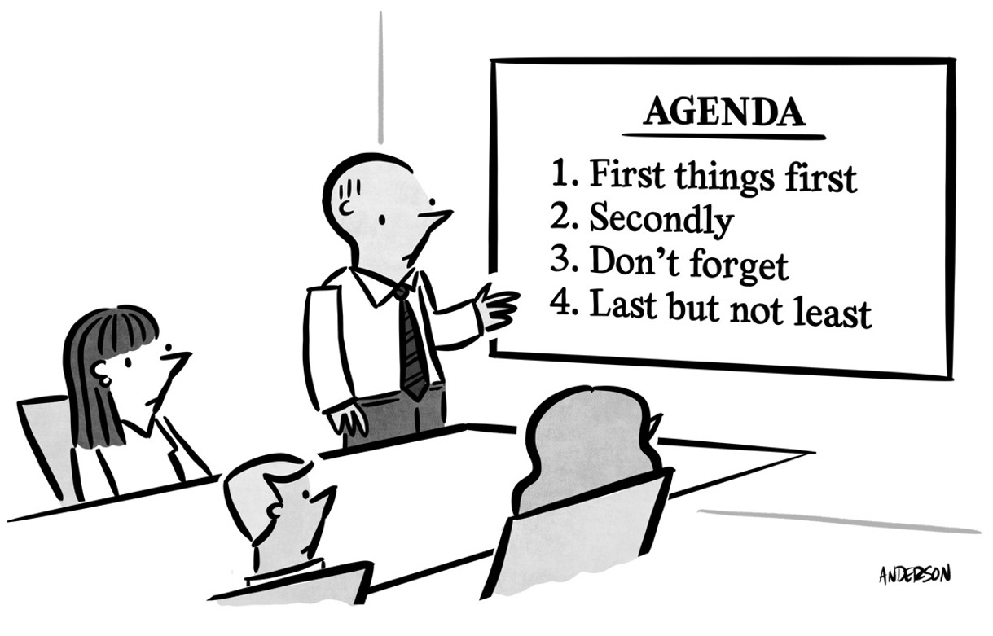
5. Adoption of Minutes from Previous AGM
  Propose – who?
  Seconder – who?
  Vote – at End

Slide 6

6. Chairperson’s Key Items
Key issues :
  Security- major upgrade and replacement of older cameras that have come to end of life
  Environmental – increased spend and alien removal
  Infrastructure – major challenges but we are engaging with the city
  Improved signage regarding beach safety
  Building issues- increase in departures etc, engaging with City
  Traffic congestion at the beach and surrounds - MOA has been signed with the City
  A huge thank you to our board members for their tireless efforts as volunteers

Slide 7
7.1 Security
LSEC members: Wesley Corbett, Carel de Ridder, Andrew Jakins
Presented by Carel de Ridder

Slide 8
7.1 Crime Statistics (2011 to 2024)
1. Crime remains very low compared with Hout Bay. Two serious events.
2. Deficiencies highlighted need upgrade camera network asap – project completed.
3. Project finished within budget - next renewal / upgrades due in 2029.
4. 109 cameras at 35 sites in Llandudno.
5. New entrance hut – discussed later in detail
…but we need to maintain & test Home Alarms & lock our gates / doors

Slide 9
7.1 Crime Incidents (1 Dec 2023 – 30 Nov 2024)
Date | Type | Road | Comment
18-Jan-24 | TOV | Fishermans Bend | Toyota Fortuner stolen; parked on street
02-Feb-24 | Theft | Llandudno Beach | Phone stolen but suspects caught thanks to car guards noticing car on arrival
10-Mar-24 | Theft | Llandudno Beach | Bag stolen from beach, suspect caught and detained; case opened by victim
30-Apr-24 | Break-in | Steensway | Copper piping stolen from out-of-sight area on proprty during windy night
13-Jun-24 | Break-in | Lower Llandudno Road | Forced entry & burglary at 10am whilst owners were out; nothing of much value taken; suspect identified but fled
20-Jun-24 | Malicious damage to property | Robinson Avenue | Windscreen smashed, bonnet scratched with rock from garden; vehicle parked outside house under a tree
Notes:
Project team - thanked for incredible service to Llandudno

Slide 10
7.1 Crime Incidents (1 Dec 2023 – 30 Nov 2024)
Date | Type | Road | Comment
13-Jul-24 | Attempted Break-in | Fishermans Bend | Balaclava gang tried to break into property but dog alerted owner; intruders left via cell phone tower
14-Jul-24 | Attempted Break-in | Fishermans Bend | Balaclava gang tried to enter property by digging under fence but didn't get into house
17-Jul-24 | Attempted Break-in | Fishermans Bend | Balaclava gang detected on mountain by thermals; intercepted by PPA & CCP; one caught, investigation lead to capture of gang
04-Aug-24 | Intruder on Premises | Leeukoppie Road | Trespasser arrested on premises (sliding door not locked, nobody home); agent advised; had number of house keys on him, claimed he was looking for food; taken to SAPS by CCP
14-Sep-24 | Armed Robbery | Sunset Avenue | Armed robbery by group of policemen in early hours of the morning; arrests have since been made after work done by detectives
Notes:
Project team - thanked for incredible service to Llandudno

Slide 11

7.1 Security – Details of Existing System (updated in Blue)
Budget – unchanged; some savings due to unrealized depreciation due to delay in implementation
Long Range Cameras on Perimeter – Thermal (all are now new generation); with on board analytics for alerts
Street View Cameras – Optical; all now upgraded new gen ColorVu (clearer in color view at night).
UPS – Stage 6 successfully endured; likely sufficient for Stage 8 as well – new sites also on UPS
Monitoring Off-Site – OmniVision; verifies triggers, calls responders to act; integration maintenance
Monitoring On-Site – S.I. Telegram messages to Responders (vehicles); alerts copied to LSEC members

Slide 12
7.1 Security – Details of Existing System (updated in Blue)
Public Open Space – dedicated LSRA funded PPA 24/7 (with dog at night); coordinated with WATCHCON (HB NW control room, managed by CCP)
Home-Alarm Response – dedicated vehicles PPA & ADT 24/7 funded by residents’ alarm contacts; both with WATCHCON radio link-up
Hut at entrance – 24/7 indirectly funded (point 8) (previously ADT, now PPA); LSRA upgrading hut
Hut at Sandy Bay – 12/7 Indirectly funded (point 8) (previously ADT, now PPA); hut to be upgraded
Car Guards – Informal arrangement, coordinated by volunteer & CCP; LSRA provides vests
WATCHON Radio for HBNW Volunteers – Lifesavers, LSEC, & CCP; upgrade under review
Communications – Emergency Contact List on web – please add to your phones

Slide 13
7.1 Security – Challenges & Plans (updated in Blue)
Speed NB – in order to catch criminals red-handed / timeously; call WATCHON asap!!
On your property – residents must maintain & set alarms; connected to a control room of choice
Camera network – residents continue to support by allowing access to property & trimming foilage
Camera testing / adjusting – Steadily handing-over to contractors to no longer rely on volunteers
Camera replacement / upgrade – all cameras bought / no need to lease (big win)
Camera Selection - trials completed on 3 preferred models for consistent set-up & maintenance
Camera sites added – Victoria Road, 1st Intersection, Main Beach parking, Main Beach, Steen Way, Paths
Car Guard Discipline – residents must report to WATCHON; who will follow-up via volunteer resident
Parking Violations / Party Houses / Noise Violations- residents report to City and must get case number from CoCT and post on W/A group for stats / record keeping / follow up
New Hut at entrance – see next slide ….

Slide 14
7.1 Security – Entrance Hut (updated in Blue)
Manning –by PPA 24/7; after achieving agreed home alarm subscription “quota”
Temporary hut at entrance – LSRA funded and equipped with donated furniture etc
Upgrade – to make something we can be proud-of, long-lasting, and multi-purpose (storage / toilet)
Lease of land – at final approval stage (has been advertised) – expecting lease to be signed soon.
Building approvals – submitted & approved – need to apply for services (waste / water / power) as soon as lease is signed - going well; estimated to be done by 28 February 2025
Construction – to commence as soon as lease is signed; estimated done by 30 April 2025
Usage – hut plus toilet; storage for environmental contractor’s equipment, radio charging
Cost - ZAR 800,000 estimated total cost (incl steps, fittings, security, shelving, solar) – big thanks for those committed to assist with donations to complete this project.

Slide 15
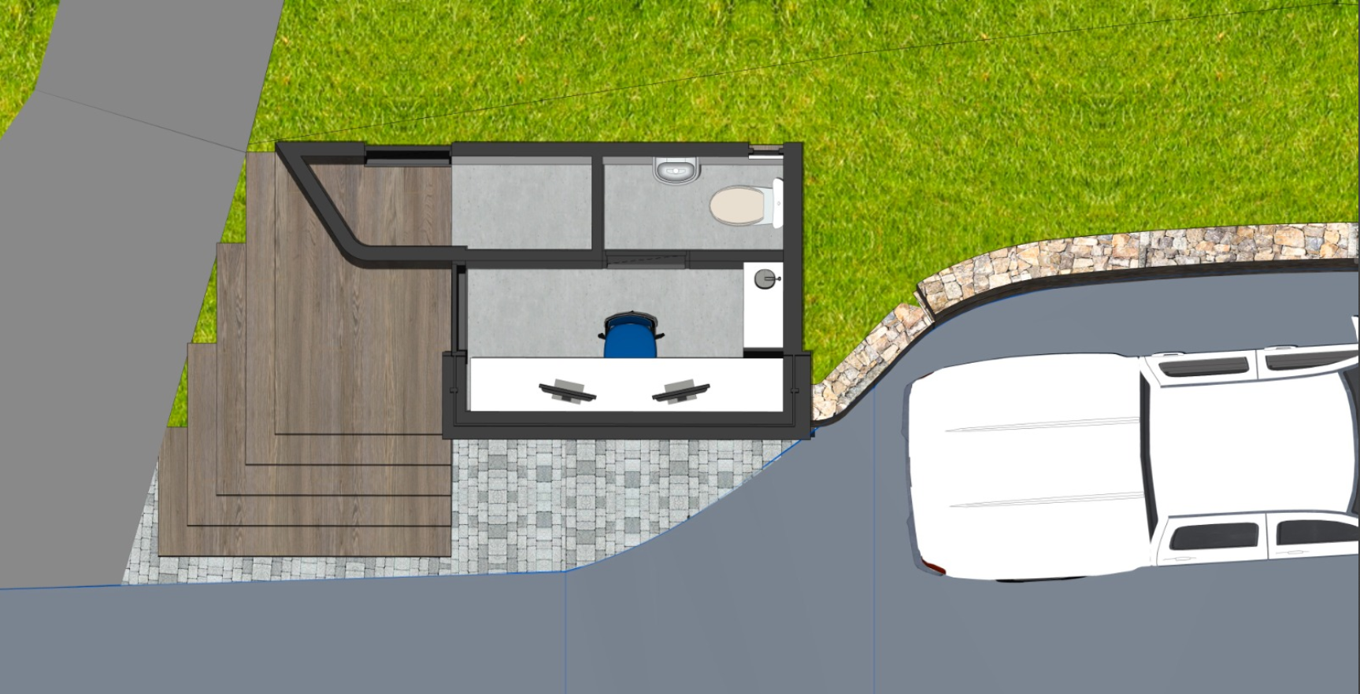

Slide 16
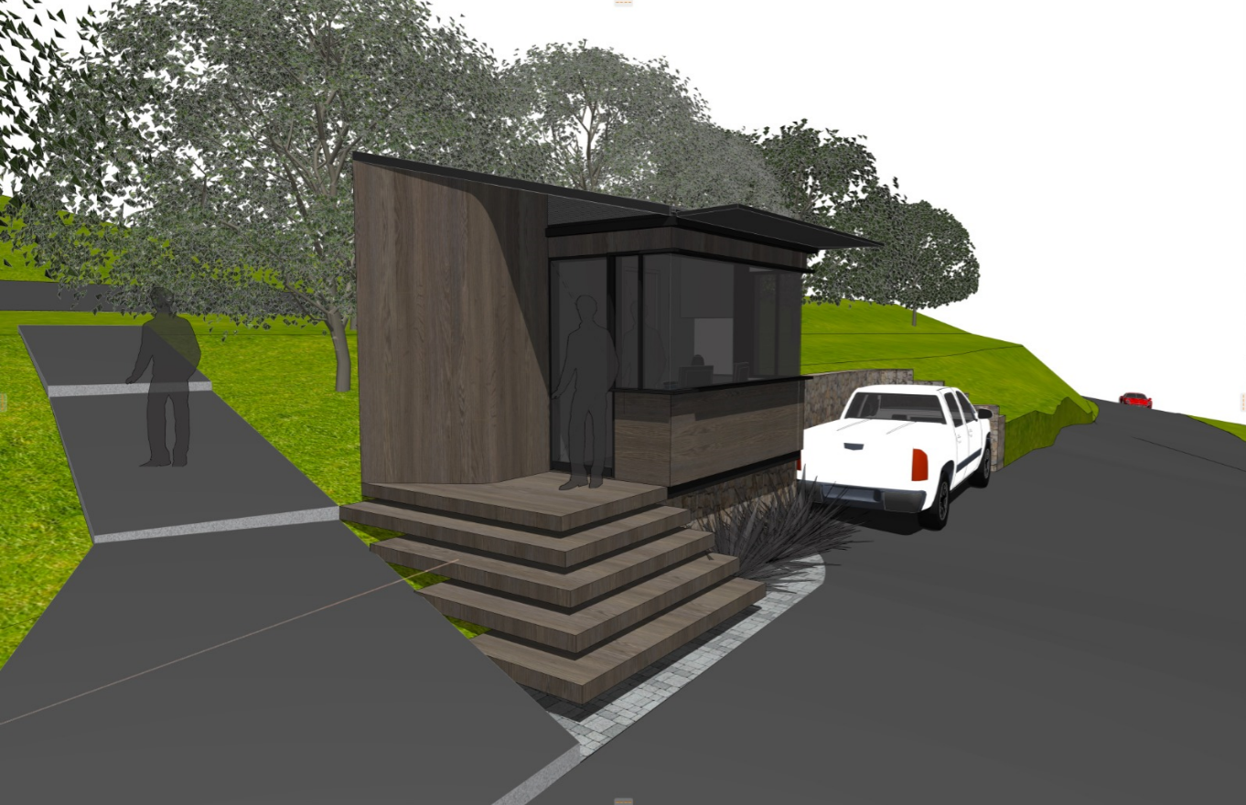

Slide 17
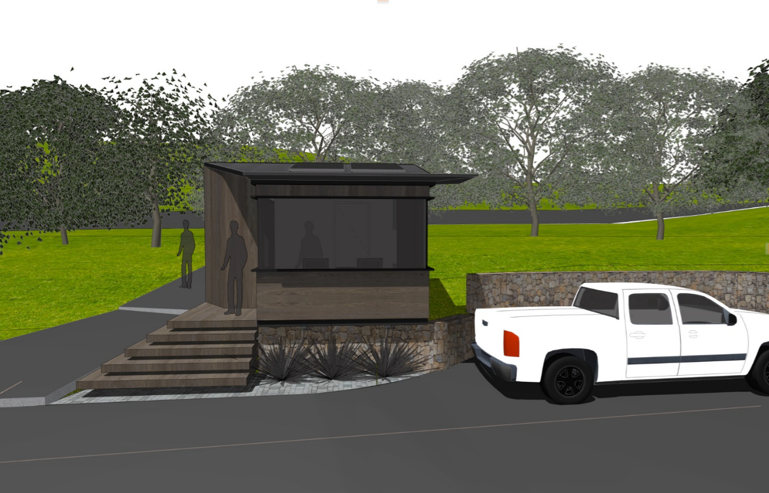

Slide 18
7.2 Environment – Environmental Report 2024
Presented by Jonathan Crowther

Slide 19
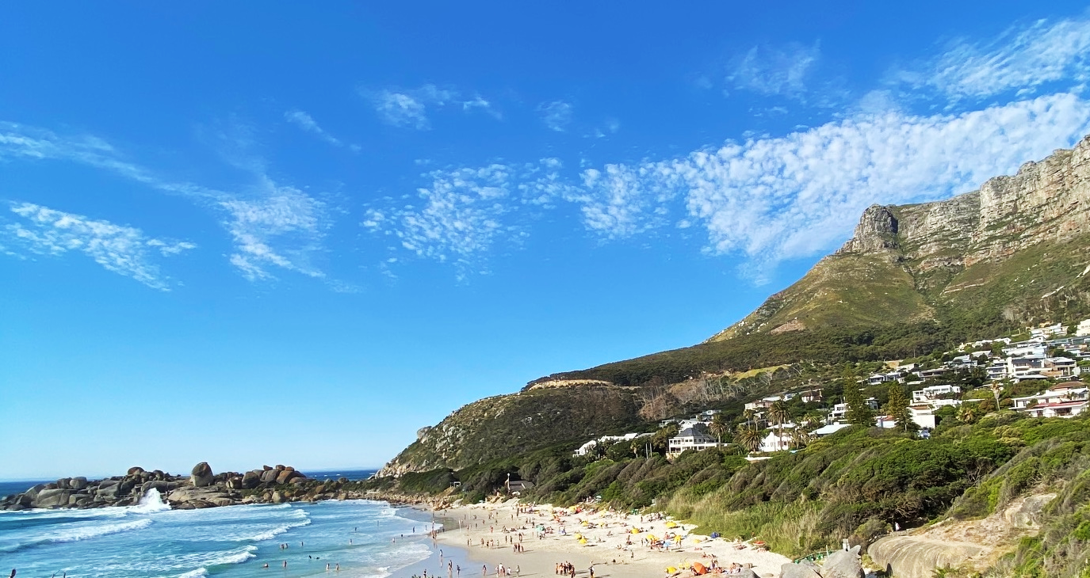
Llandudno SRA: Environmental Report 2024
  Alien Clearing
  Fire
  Vegetation Cutting, Removal and Dumping
  Beach Access Upgrade
  Litter and Bins
Notes:
3 x topics.

Slide 20
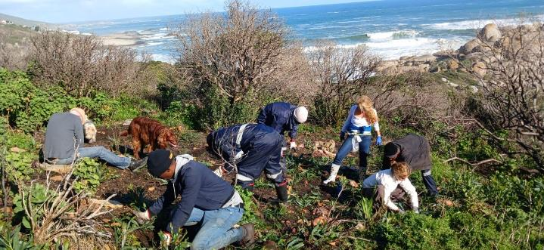
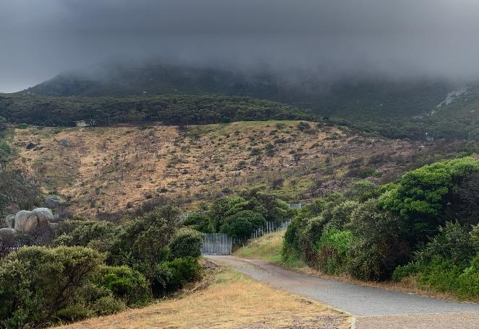
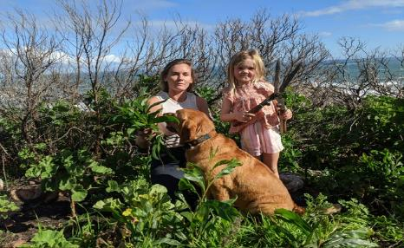

Alien Clearing
Northern Firebreak and area burnt by fire
Ongoing clearing of the alien species Port Jackson by Sugarbird Trust and Weavers. Donation made to Sugarbird.
Mandela Day Hack on 20 July 2024 – supported by about 25 residents of all ages and dogs.
Status – up to approx. 95 % of Port Jackson and all old dead gum trees have been removed from the west facing slope north of the firebreak.
Will need ongoing hacks to remove alien vegetation regrowth. Weavers will also support in this regard.
Thanks to Catherine Moss for facilitating Sugarbird clearing.

Slide 21
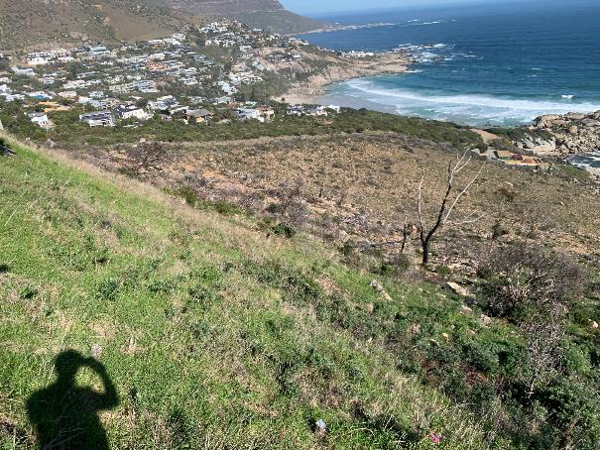
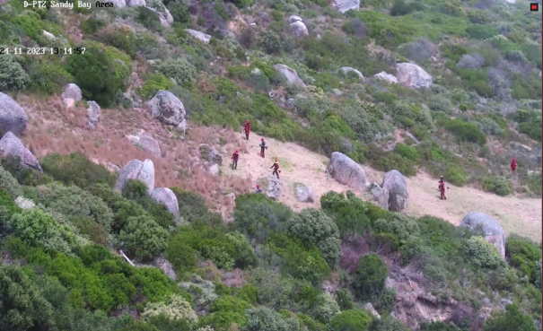
Alien Clearing
Other Areas
Alien vegetation species were and continue to be removed from public open spaces across Llands
Cleared Port Jackson inside waste water treatment works
Cut back Port Jackson and Manatoka on Logies Bay rocks
SANParks Firebreak Clearing
SANParks has confirmed that they will be clearing the firebreaks on north and south side of Llands in the first two weeks of December (residents notified via WhatsApp).
Weaver team maintains alien vegetation control along firebreaks between annual clearing.

Slide 22
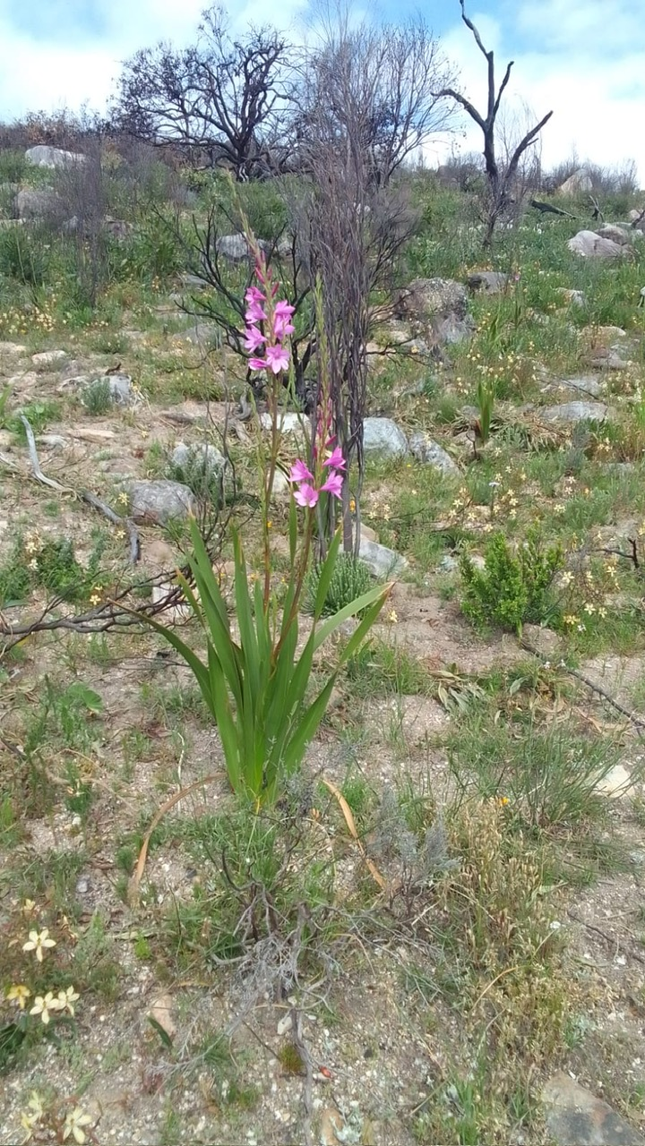
Fire
TIPS TO PROTECT YOURSELF AND YOUR HOME:
Minimising fire risk is each homeowner’s responsibility
SANParks fire officer re-iterated this point. First line of defense is ensure that your own property is free of aliens and that any vegetation in close proximity to house is cleared
Keep all access roads and hydrants free for fire department
Clear gutters ahead of the dry summer season
Garden hoses will be minimally effective

Slide 23
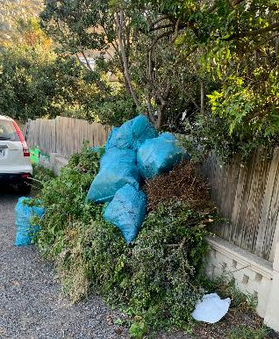
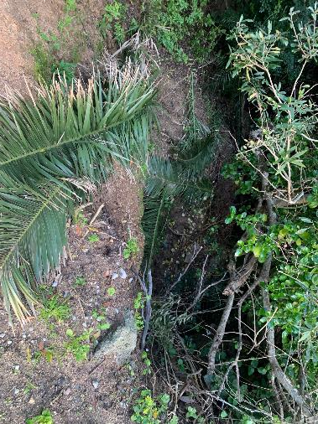
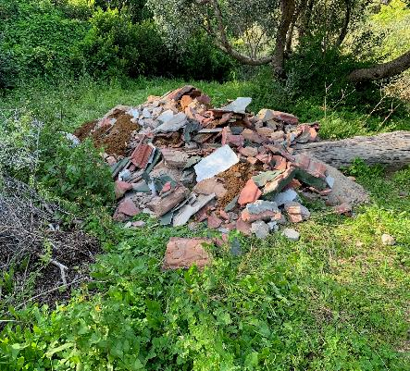
Vegetation Cutting, Removal & Dumping
  Cutting back of bush along all access paths to main beach, coastal paths and along the road
  Substantial clearing of three sections of the Gulley path.
  Trimming trees along main access roads
  Slowly working along other roads to remove weeds and bushes leaning into the road
  Clearing stormwater drains
  General cutting and weeding of public open spaces
  Dumping: A number of residents/their staff dump garden refuse in open spaces and the river courses. If this is observed, please report so that we can follow-up. The SRA does not in principle attend to private dumping.
  NOTE: SRA does not cut trees planted by residents on the road verges. When trees and bushes are hanging over the road and obstructing traffic, please ask your service providers to remove such material.

Slide 24
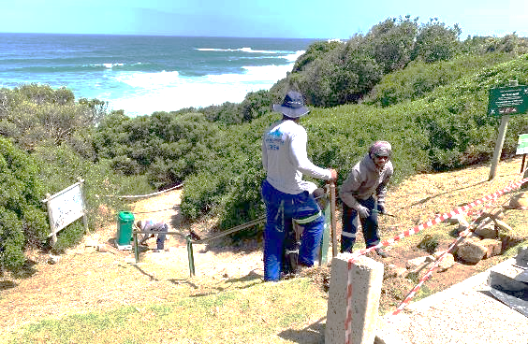
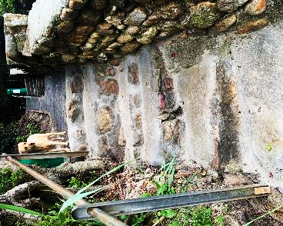
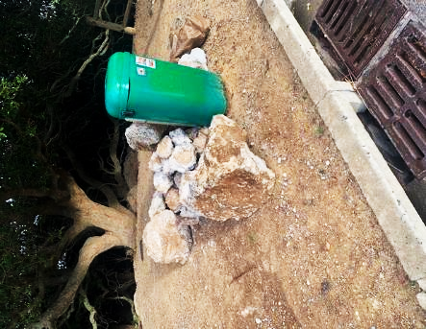
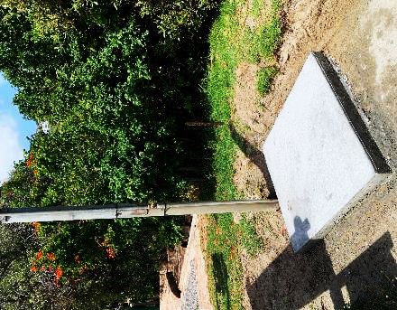
Beach Access Upgrade
  Met with Head Coastal and Marine Management of CCT. Identified activities that could be undertaken to upgrade access and generally tidy up beach
  Upgraded steps – Gulley Stream and central beach access
  New platform for shower
  Remove broken poles and concrete blocks from various locations
  We are busy trying to solve the water leaking onto steps at the Gulley Stream access onto the beach. Currently very slippery and dangerous. Have cut drainage channels, but need more. If solution does not work then may consider elevated steps.

Slide 25


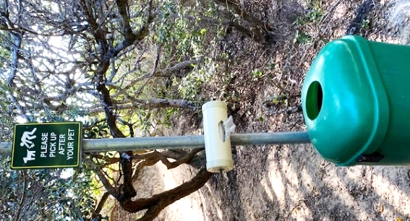
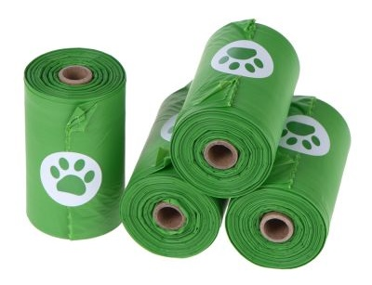
Litter & Bins
Please take responsibility for clearing up after your dogs. Fortunately we do have one or two fairies that do clear up almost daily (Morag and Sandy – thanks for picking up after others).

Slide 26
7.3 Infrastructure
Presented by Andrew McNulty

Slide 27
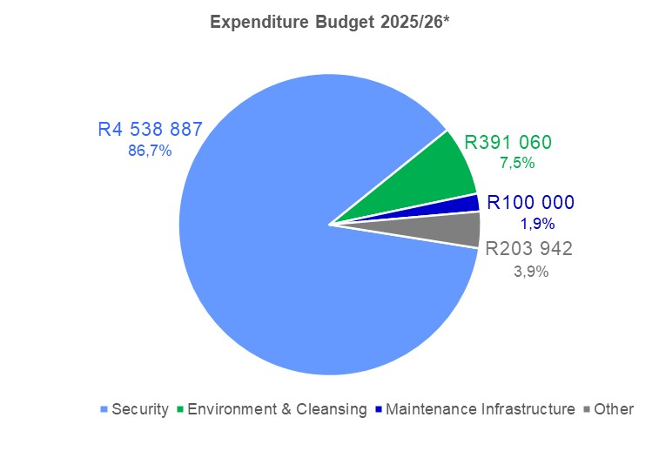
7.3a Background
Previously, no mandate / budget for Infrastructure in 5-year plan. Small budget 2024/25 onwards
Rely on CoCT services, responsiveness, etc.
Four (Five) Infrastructural Areas:
  1. Road Maintenance & Signage
  2. Electricity
  3. Sewerage
  4. Water
  (5. Parking & Traffic Congestion)
*excludes Bad Debt provisions

Slide 28


7.3b Road Maintenance & Signage
Road Maintenance & Signage
Built up relationships & contacts with the CoCT
Thirty (notified) items addressed over 58 months (two large projects)
  Potholes, painted road lines, unblocking storm water channels, new signs
  Response time has been good except during hard lockdown
  Slower response during 2024 coinciding with large and increasing numbers of building projects in Llandudno

Slide 29

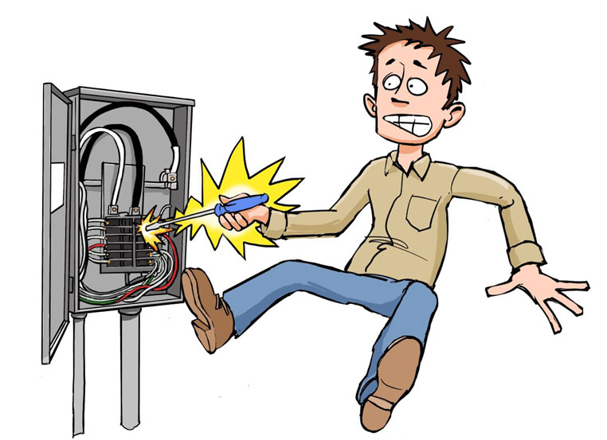

7.3c Electricity
Ignoring load shedding, much less power failure problems during 2024 compared to 2022 and 2021
Gulley Road Substation and Steens Way – hotspots
Addressed by CoCT as a project (priority)
In general, responsiveness from CoCT is good

Slide 30


7.3d Sewerage
Recurring problem of sewerage leaks
43 (notified) faults over the past 52 months
CoCT fixes most faults promptly
LSRA Infrastructure sub-committee
  Discussions with City official to provide preventative maintenance
  Large building project impact
  Prior to LSRA Budget

Slide 31



7.3e Water
Water faults (burst pipes) increased compared to 2023
42 (notified) faults since January 2024 (30 during 2023)
CoCT fixes most faults promptly
Wider Community Water Crisis - parts of Hout Bay more severely impacted. Trying to canvass support from wider Municipal Ward to have a stronger collective voice on water problems
Plea: Report on the WhatsApp Group – tracking and ability to escalate with Counsillor

Slide 32
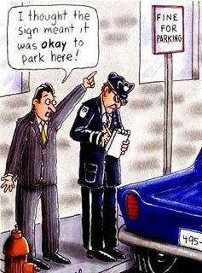


7.3f Parking & Traffic Congestion
Mr CF Sammeli (local resident) commissioned a traffic consultant to assess the problem(s) and make recommendations, liaise with the City and the LSRA/Community
Dedicated officer – trial – Dec 24 to Feb 25
Please report traffic violations – collective reporting does have impact (e.g. weekend 5th & 6th October)

Slide 33
8. Finance
Presented by Ian Scott

Slide 34

8.1 Statement of Financial Position as at 30 June 24

Slide 35
8.2 Statement of Comprehensive Income
Statement of Comprehensive Income continued
2024
2023
2024
2023

Slide 36


8.3 Commentary
Clean Audit Report
Income Tax Exempt
Additions to Property Plant and Equipment of R 30 338– paid cash
Repairs & Maintenance managed well at R 31 419 this year.
Net book value of Property Plant & Equipment now R 483 095 after the above additions
Surplus income for the year of R 87 1916 ( R759 353 in 2023) and cumulative surplus of R3 210 375

Slide 37
8.3 Commentary
Cash reserves of R 2 856 957 at year end (up from R 1 467 091 in 2023)
Expenditure increased by 10.6 % (cleaning and environment and public safety)
Income increased by 12.68 % as a result of budgeted income increase of 8.5 % and release of retentions of R 347 558
Interest received increased to R 138 849 from R 90 131 in 2023.
Aim is to build cash reserves further and to pay cash for new cameras which were meant to be purchased this year but delayed into 2025.
This will mean higher depreciation but no leasing costs once current lease ends (was a cost of ± R 240 000 p.a.)
Surplus going forward will be allocated to new projects and a capital expenditure reserve which will be used to replace equipment

Slide 38
8.4 Implementation & Business Plan
The Financial Year runs from 1 July to 30 June
Additional rates are determined every 5 years through a detailed process:
  5-year Business & Implementation Plan
  5-year Budget
Budgeting is done on a Cash Flow basis with Income = Expenses + Capex
The approval process is rigorous:
  Debated & Approved by the LSRA Board
  Submitted for Modeling & Approval by the City of Cape Town
  Tabled for Approval at the LSRA AGM
The new current 5 year Budget & Plans 2025 – 2029 as approved at 2023 AGM

Slide 39
8.5 Increase in SRA Levy on Rates Bill
6.5 % from 1st July 2024 (down from 8.5 % last year )
The actual amount charged to each property is determined by the relative value of each property to the total municipal value of the whole of Llandudno
    e.g: If your property is valued at 1% of the total value of Llandudno, your additional rates bill will be 1% of the budget of the LSRA
Irrespective of what changes there are in the municipal values, the owners are charged and the LSRA receives the Budgeted Income only
The municipal revaluations every 3 years does not impact this budget as we only recover agreed budget.
  An overall higher valuation does not automatically translate to a higher budget
  An overall change in municipal valuations only determines the proportionate amount charged to each property
  1% different in rates increase only amounts to 46 000 per annum which divided by the number of properties is miniscule

Slide 40
8.6 Year to Date – 2025
40

Slide 41
Year to Date - 2025 Continued
Jul – Sep 24
YTD Budget
Annual Budget
Monthly depreciation increases to R33642 from Oct – new cameras

Slide 42
8.7 2025/26
Proposed Amended Budget

Slide 43
9. Election of the Board
Kiki Loubser

Slide 44
9.1 Board Currently
No. | Surname | First Name | Term | Term | No. of Terms | First Appointed to AGM | Re-appointed to AGM | Rotation 2020 | Rotation 2021 | Rotation 2022 | Rotation 2023 | Rotation 2024
1 | Scott | Ian | 3 years | 3 years | 1 | 2021 |  | X |  |  |  | X
2 | Jakins | Andrew | 3 years | 3 years | 1 | 2021 |  | X |  |  |  | X
3 | Bond-Smith nee Loubser | Kiki | 3 years | 3 years | 4 | 2014* | 2017 |  | x |  | X
4 | Curtis | Rob | 3 years | 3 years | 1 | 2021
5 | Aufrichtig | Jody | 3 years | 3 years | 3 | 2016 | - |  |  | X
6 | Corbett | Wesley | 3 years | 3 years | 3 | 2017 | - | X |  | X | X
7 | Greig | Mark | 3 years | 3 years | 2 | 2018 | - |  | X |  | X
8 | McNulty | Andrew | 3 years | 3 years | 2 | 2018 | - |  | X |  |  | X
9 | Crowther | Jonathan | 3 years | 3 years | 1 | 2020 |  |  |  | X
Co-Opted Members
No. | Surname | First Name | Term |  | No. of Terms | First Appointed | Appointed to Board |  | Status as a co-opted member
9
10
11
Legend
* | Appointed at Special General Meeting on formation of Company

Slide 45
9.2 Board Proposed for Election
 | Name | Current Portfolio | Status | Action
1 | Kiki Loubser | Chair | Current
2 | Wesley Corbett | Security | Current
3 | Jody Aufrichtig | Projects | Current
4 | Ian Scott | Treasurer | Resign by rotation | Stand for reappointment
5 | Andrew Jakins | Security / Infrastructure | Resign by rotation | Stand for reappointment
6 | Jonathan Crowther | Environment / Beach / Social Development | Current
7 | Rob Curtis | Communication | Current
8 | Andrew McNulty | City Liaison / Finance / Infrastructure | Resign by rotation | Stand for reappointment
9 | Mark Greig | Legal / Environment | Current

Slide 46

10. Q & A

Slide 47
11. Statutory Approvals
Kiki Loubser

Slide 48

11. Statutory Approvals - Voting
Ratification of Board Decision ref. Electronic Meeting
Approval of Minutes of the Previous AGM
Adoption of the Audited Financials 2023-2024
Adoption of Base Case Budget FY 2025/2026
Adoption of Implementation Plan 2024-29
Appointment of Auditors
Confirmation of Company Secretary
Election of Board Members

Slide 49

13. Meeting Closed

Slide 50
Appendix: Chairperson’s Key Items
 | SRA | LCA
1 | Registered property owners are eligible to be members - not automatic, must apply | Any resident may become a member
2 | Membership is voluntary | Membership is voluntary
3 | Contributions to levies is NOT voluntary, levied by City of Cape Town, based on property value | Contributions are set and Administered by the LCA and are voluntary
4 | Areas of Operation/Scope: | Areas of Operation/Scope:
 | 4.1 Public open areas, and environment | Property Owners' built environment - LBAC
 | 4.2 Security of suburb - public areas | Building regulations and enforcement
 | 4.3 Environment | Vision re densification of the suburb
 | 4.4 Clearing services - top up, beaches, paths etc. | NIMBY = not in my back yard
 | 4.5 Future: marine environment | Need for residents to know the regulations and participate actively to try to prevent further issues Rates affordability & Valuations objections

